Slide 1
Artificial Neural Networks
اَعُوذُ بِاللہِ مِنَ الشَّیِطٰنِ الرَّجِیمْ
بِسْمِ اللہِ الرَّحَمٰنِ الرَّحِیمْ
Note: Some slides and/or pictures are adapted from Lecture slides / Books of
https://www.coursera.org/specializations/deep-learning
https://d2l.ai/chapter_preface/index.html
https://deeplearning.cs.cmu.edu/S23/index.html

Slide 2
Topics for the day
What can neural networks represent
And what are the restrictions
– In terms of “depth”, “width” and “activations”

Slide 3




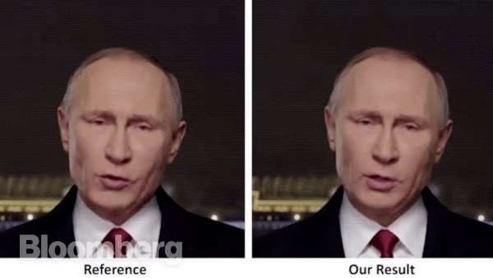

Neural networks have taken over AI
Tasks that are made possible by NNs, aka deep learning
– Tasks that were once assumed to be purely in the human domain of expertise

Slide 4
So what are neural networks??
N.Net
N.Net
Voice signal
Image
Transcription
Text caption
N.Net
Game State
Next move
What are these boxes?
Functions that take an input and produce an output
What are these functions?

Slide 5
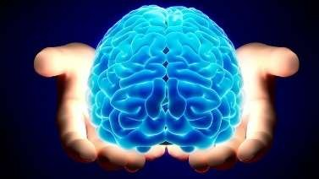
The human perspective
N.Net
N.Net
Voice signal
Image
Transcription
Text caption
N.Net
Game State
Next move
In a human, those functions are computed by the brain…

Slide 6

NNets and the brain
In their basic form, NNets mimic the networked structure in the brain

Slide 7

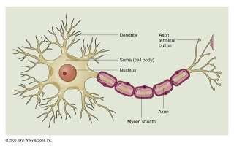
The brain
The Brain is composed of networks of neurons

Slide 8
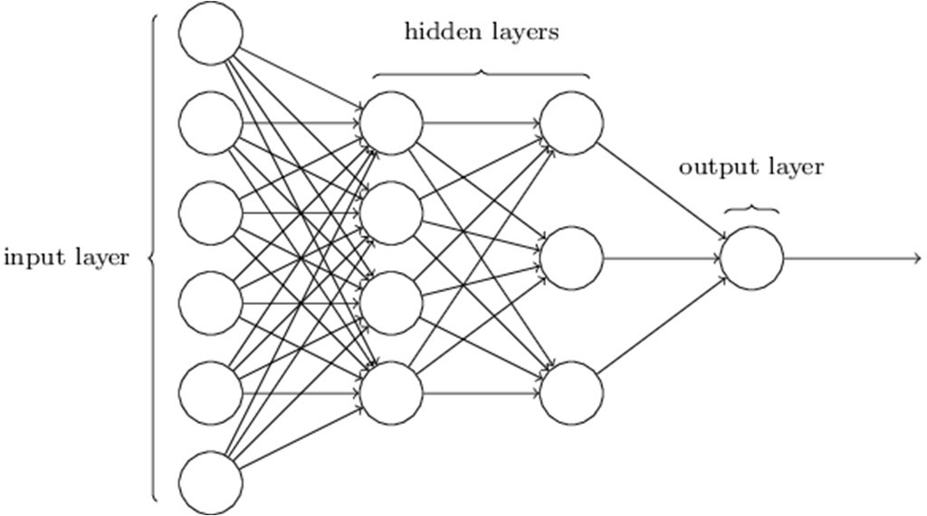
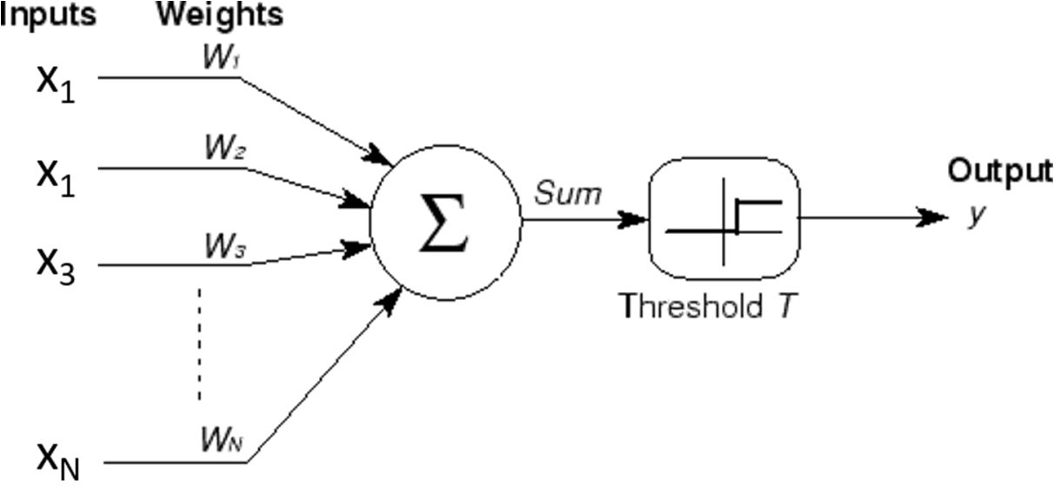

Nnets and the brain
Neural nets are composed of networks of computational models of neurons called perceptrons

Slide 9
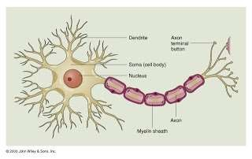
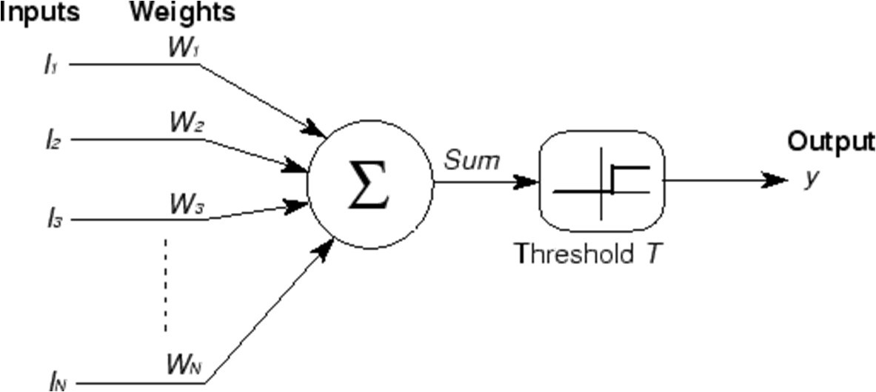
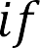
Recap: the perceptron
x₁
x₁
x₃
i i
i
x_{N}
A threshold unit
“Fires” if the weighted sum of inputs exceeds a threshold
Electrical engineers will call this a threshold gate
A basic unit of Boolean circuits

Slide 10


A better figure
Linear vs Affine?
1
1
.
2
i i
i
2
3
.
3
+
.
N
N
A threshold unit
“Fires” if the affine function of inputs is positive
The bias is the negative of the threshold T in the previous slide

Slide 11
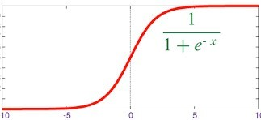
The “soft” perceptron (logistic)
1
1
i i
i
2
2
.
3
3
+
.
N
N
A “squashing” function instead of a threshold at the output
The sigmoid “activation” replaces the threshold
Activation: The function that acts on the weighted combination of inputs (and bias)

Slide 12
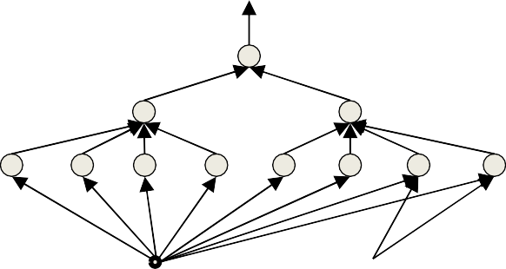
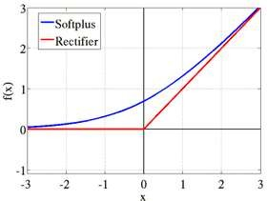
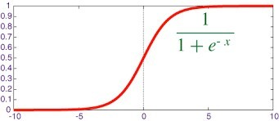
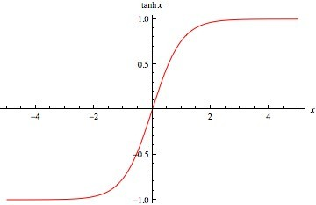
Other “activations”
x₁ x₂
𝑤₁
𝑤₂
𝑤₃
x₃
.
𝑧
.
+
𝑦
.
.
𝑤_{N}
𝑏
x_{N}
sigmoid
tanh
log(1 + 𝑒^{z})
1
tanh(𝑧)
1 + exp(−𝑧)
Does not always have to be a squashing function
– We will hear more about activations later
We will continue to assume a “threshold” activation in this lecture

Slide 13
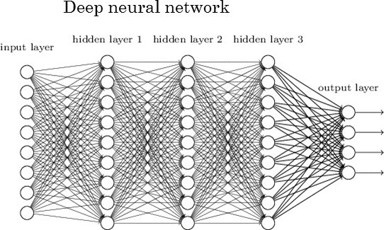








The multi-layer perceptron
A network of perceptrons
Perceptrons “feed” other perceptrons
We give you the “formal” definition of a layer later

Slide 14
Defining “depth”
What is a “deep” network

Slide 15
Deep Structures
In any directed graph with input source nodes and output sink nodes, “depth” is the length of the longest path from a source to a sink
A “source” node in a directed graph is a node that has only outgoing edges
A “sink” node is a node that has only incoming edges
Left: Depth = 2.
Right: Depth = 3

Slide 16
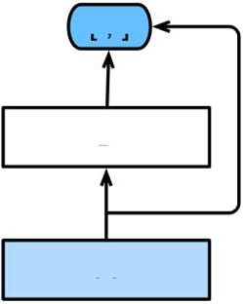
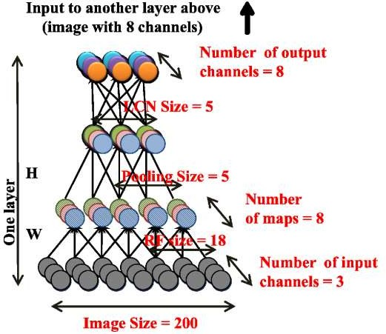
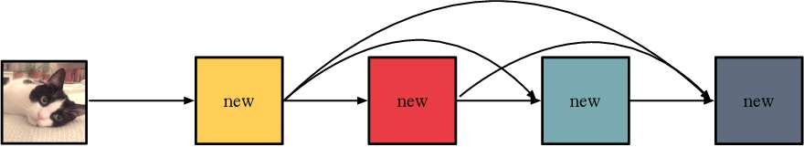
Deep Structures
Deep structure
The input is the “source”,
The output nodes are “sinks”
•
“Deep” → Depth of output neurons is greater than 2

Slide 17
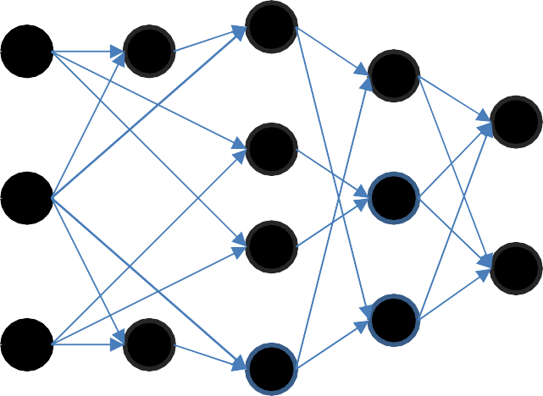
What is a layer?
A “layer” is the set of neurons that are all at the same depth with respect to the input (sink)
– “Depth” of a layer – the depth of the neurons in the layer w.r.t. input
No of Neurons on each layer?
Input:
Layer 1:
Layer 2:
Layer 3:
Layer 4:
“Deep” → At least 3 layers
– Output layer depth is at least 3

Slide 18
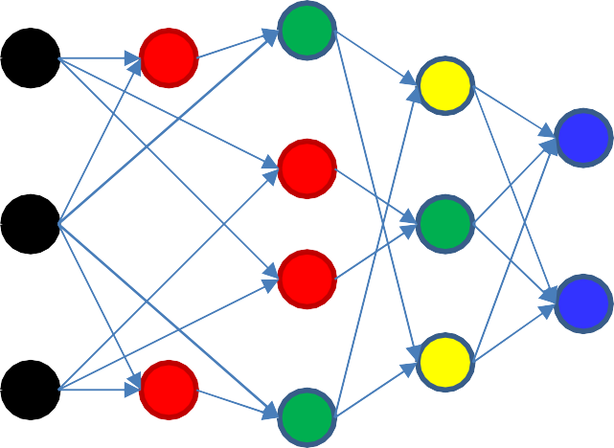
What is a layer?
A “layer” is the set of neurons that are all at the same depth with respect to the input (sink)
– “Depth” of a layer – the depth of the neurons in the layer w.r.t. input
Input: Black Layer 1: Red
Layer 2: Green
Layer 3: Yellow
Layer 4: Blue
•
“Deep” → At least 3 layers
– Output layer depth is at least 3

Slide 19




The multi-layer perceptron
N.Net
Inputs are real or Boolean stimuli
Outputs are real or Boolean values
Can have multiple outputs for a single input
What can this network compute?
What kinds of input/output relationships can it model?

Slide 20
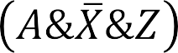
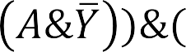



MLPs approximate functions
2
1
1
2
0
1
n
1
-1
1
1
x
2
1
2
1
2
1
-1
1
1 1 1
-1 1
X Y Z A
MLPs can compose Boolean functions
MLPs can compose real-valued functions
What are the limitations?

Slide 21
Today
Multi-layer Perceptrons as universal Boolean functions
The need for depth
MLPs as universal classifiers
The need for depth
MLPs as universal approximators
A discussion of optimal depth and width

Slide 22
Today
Multi-layer Perceptrons as universal Boolean functions
– The need for depth
MLPs as universal classifiers
– The need for depth
MLPs as universal approximators
A discussion of optimal depth and width

Slide 23
The MLP as a Boolean function
How well do MLPs model Boolean functions?

Slide 24


The perceptron as a Boolean gate
X
1
-1
2
X
0
1
Y
X
1
1
1
Y
Values in the circles are thresholds Values on edges are weights
A perceptron can model any simple binary Boolean gate

Slide 25








Perceptron as a Boolean gate
1
1
1
-1
-1
L
-1
Will fire only if X₁ .. X_{L} are all 1 and X_{L+1} .. X_{N} are all 0
The universal AND gate
AND any number of inputs
Any subset of who may be negated

Slide 26








Perceptron as a Boolean gate
1
1
1
-1
-1
L-N+1
-1
Will fire only if any of X₁ .. X_{L} are 1 or any of X_{L+1} .. X_{N} are 0
The universal OR gate
OR any number of inputs
Any subset of who may be negated

Slide 27



Perceptron as a Boolean Gate
1
1
Will fire only if at least K inputs are 1
1
1
1
K
1
Generalized majority gate
– Fire if at least K inputs are of the desired polarity

Slide 28
The perceptron is not enough
X
?
?
?
Y
Cannot compute an XOR

Slide 29
Multi-layer perceptron
X
1
1
1
-1
2
1
1
-1
-1
Y
Hidden Layer
MLPs can compute the XOR

Slide 30
Multi-layer perceptron XOR
X
1
1
-2
2
1
1
1
Thanks to Gerald Friedland
Y
With 2 neurons
– 5 weights and two thresholds

Slide 31
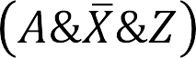




Multi-layer perceptron
2
1
1
0
1
1
-1
1
1
2
1
2
1
2
1
-1
1
1 1 1
-1 1
X Y Z A
MLPs can compute more complex Boolean functions
MLPs can compute any Boolean function
– Since they can emulate individual gates
MLPs are universal Boolean functions

Slide 32
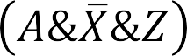



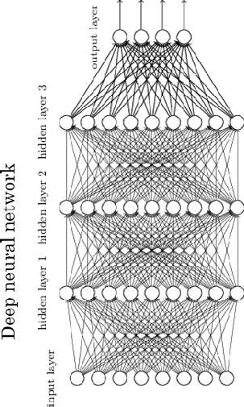
MLP as Boolean Functions
2
1
1
0
1
1
-1
1
1
2
1
2
1
2
1
-1
1
1 1 1
-1 1
X
Y
Z
A
MLPs are universal Boolean functions
– Any function over any number of inputs and any number of outputs
But how many “layers” will they need?

Slide 33
How many layers for a Boolean MLP?
Truth table shows all input combinations
Truth Table
for which output is 1
X₁ | X₂ | X₃ | X₄ | X₅ | Y
0 | 0 | 1 | 1 | 0 | 1
0 | 1 | 0 | 1 | 1 | 1
0 | 1 | 1 | 0 | 0 | 1
1 | 0 | 0 | 0 | 1 | 1
1 | 0 | 1 | 1 | 1 | 1
1 | 1 | 0 | 0 | 1 | 1
A Boolean function is just a truth table

Slide 34





How many layers for a Boolean MLP?
Truth table shows all input combinations
Truth Table
for which output is 1
X₁ | X₂ | X₃ | X₄ | X₅ | Y
0 | 0 | 1 | 1 | 0 | 1
0 | 1 | 0 | 1 | 1 | 1
0 | 1 | 1 | 0 | 0 | 1
1 | 0 | 0 | 0 | 1 | 1
1 | 0 | 1 | 1 | 1 | 1
1 | 1 | 0 | 0 | 1 | 1
1 2 3 4 5
1 2 3 4 5
1 2 3 4 5
1 2 3 4 5
1 2 3 4 5
1 2 3 4 5
Expressed in disjunctive normal form

Slide 35
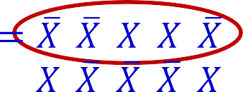
How many layers for a Boolean MLP?
Truth table shows all input combinations
Truth Table
for which output is 1
X₁ | X₂ | X₃ | X₄ | X₅ | Y
0 | 0 | 1 | 1 | 0 | 1
0 | 1 | 0 | 1 | 1 | 1
0 | 1 | 1 | 0 | 0 | 1
1 | 0 | 0 | 0 | 1 | 1
1 | 0 | 1 | 1 | 1 | 1
1 | 1 | 0 | 0 | 1 | 1
1 2 3 4 5
1 2 3 4 5
1 2 3 4 5
1 2 3 4 5
1 2 3 4 5
1 2 3 4 5
X₁ X₂ X₃ X₄
Expressed in disjunctive normal form
X₅

Slide 36
How many layers for a Boolean MLP?
Truth table shows all input combinations
Truth Table
for which output is 1
X₁ | X₂ | X₃ | X₄ | X₅ | Y
0 | 0 | 1 | 1 | 0 | 1
0 | 1 | 0 | 1 | 1 | 1
0 | 1 | 1 | 0 | 0 | 1
1 | 0 | 0 | 0 | 1 | 1
1 | 0 | 1 | 1 | 1 | 1
1 | 1 | 0 | 0 | 1 | 1
1 2 3 4 5
1 2 3 4 5
1 2 3 4 5
1 2 3 4 5
1 2 3 4 5
1 2 3 4 5
X₁ X₂ X₃ X₄
Expressed in disjunctive normal form
X₅

Slide 37
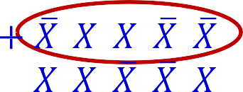
How many layers for a Boolean MLP?
Truth table shows all input combinations
Truth Table
for which output is 1
X₁ | X₂ | X₃ | X₄ | X₅ | Y
0 | 0 | 1 | 1 | 0 | 1
0 | 1 | 0 | 1 | 1 | 1
0 | 1 | 1 | 0 | 0 | 1
1 | 0 | 0 | 0 | 1 | 1
1 | 0 | 1 | 1 | 1 | 1
1 | 1 | 0 | 0 | 1 | 1
1 2 3 4 5
1 2 3 4 5
1 2 3 4 5
1 2 3 4 5
1 2 3 4 5
1 2 3 4 5
X₁ X₂ X₃ X₄
Expressed in disjunctive normal form
X₅

Slide 38
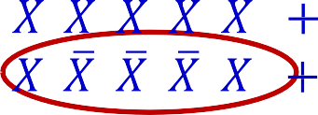
How many layers for a Boolean MLP?
Truth table shows all input combinations
Truth Table
for which output is 1
X₁ | X₂ | X₃ | X₄ | X₅ | Y
0 | 0 | 1 | 1 | 0 | 1
0 | 1 | 0 | 1 | 1 | 1
0 | 1 | 1 | 0 | 0 | 1
1 | 0 | 0 | 0 | 1 | 1
1 | 0 | 1 | 1 | 1 | 1
1 | 1 | 0 | 0 | 1 | 1
1 2 3 4 5
1 2 3 4 5
1 2 3 4 5
1 2 3 4 5
1 2 3 4 5
1 2 3 4 5
X₁ X₂ X₃ X₄
Expressed in disjunctive normal form
X₅

Slide 39
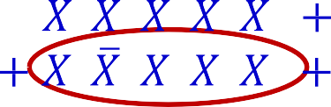
How many layers for a Boolean MLP?
Truth table shows all input combinations
Truth Table
for which output is 1
X₁ | X₂ | X₃ | X₄ | X₅ | Y
0 | 0 | 1 | 1 | 0 | 1
0 | 1 | 0 | 1 | 1 | 1
0 | 1 | 1 | 0 | 0 | 1
1 | 0 | 0 | 0 | 1 | 1
1 | 0 | 1 | 1 | 1 | 1
1 | 1 | 0 | 0 | 1 | 1
1 2 3 4 5
1 2 3 4 5
1 2 3 4 5
1 2 3 4 5
1 2 3 4 5
1 2 3 4 5
X₁ X₂ X₃ X₄
Expressed in disjunctive normal form
X₅

Slide 40
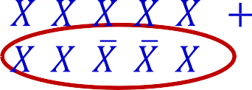
How many layers for a Boolean MLP?
Truth table shows all input combinations
Truth Table
for which output is 1
X₁ | X₂ | X₃ | X₄ | X₅ | Y
0 | 0 | 1 | 1 | 0 | 1
0 | 1 | 0 | 1 | 1 | 1
0 | 1 | 1 | 0 | 0 | 1
1 | 0 | 0 | 0 | 1 | 1
1 | 0 | 1 | 1 | 1 | 1
1 | 1 | 0 | 0 | 1 | 1
1 2 3 4 5
1 2 3 4 5
1 2 3 4 5
1 2 3 4 5
1 2 3 4 5
1 2 3 4 5
X₁ X₂ X₃ X₄
Expressed in disjunctive normal form
X₅

Slide 41
How many layers for a Boolean MLP?
Truth table shows all input combinations
Truth Table
for which output is 1
X₁ | X₂ | X₃ | X₄ | X₅ | Y
0 | 0 | 1 | 1 | 0 | 1
0 | 1 | 0 | 1 | 1 | 1
0 | 1 | 1 | 0 | 0 | 1
1 | 0 | 0 | 0 | 1 | 1
1 | 0 | 1 | 1 | 1 | 1
1 | 1 | 0 | 0 | 1 | 1
1 2 3 4 5
1 2 3 4 5
1 2 3 4 5
1 2 3 4 5
1 2 3 4 5
1 2 3 4 5
X₁ X₂ X₃ X₄
Expressed in disjunctive normal form
X₅

Slide 42
How many layers for a Boolean MLP?
Truth table shows all input combinations
Truth Table
for which output is 1
X₁ | X₂ | X₃ | X₄ | X₅ | Y
0 | 0 | 1 | 1 | 0 | 1
0 | 1 | 0 | 1 | 1 | 1
0 | 1 | 1 | 0 | 0 | 1
1 | 0 | 0 | 0 | 1 | 1
1 | 0 | 1 | 1 | 1 | 1
1 | 1 | 0 | 0 | 1 | 1
1 2 3 4 5
1 2 3 4 5
1 2 3 4 5
1 2 3 4 5
1 2 3 4 5
1 2 3 4 5
X₁ X₂ X₃ X₄ X₅
Any truth table can be expressed in this manner!
A one-hidden-layer MLP is a Universal Boolean Function

Slide 43
How many layers for a Boolean MLP?
Truth table shows all input combinations
Truth Table
for which output is 1
X₁ | X₂ | X₃ | X₄ | X₅ | Y
0 | 0 | 1 | 1 | 0 | 1
0 | 1 | 0 | 1 | 1 | 1
0 | 1 | 1 | 0 | 0 | 1
1 | 0 | 0 | 0 | 1 | 1
1 | 0 | 1 | 1 | 1 | 1
1 | 1 | 0 | 0 | 1 | 1
1 2 3 4 5
1 2 3 4 5
1 2 3 4 5
1 2 3 4 5
1 2 3 4 5
1 2 3 4 5
X₁ X₂ X₃ X₄ X₅
Any truth table can be expressed in this manner!
A one-hidden-layer MLP is a Universal Boolean Function
But what is the largest number of perceptrons required in the single hidden layer for an N-input-variable function?
Notes:
But what is the largest number of perceptrons required in the single hidden layer for an N-input-variable function? Exponential

Slide 44
Reducing a Boolean Function
_{WX} YZ
00
00 01 11 10
This is a “Karnaugh Map”
It represents a truth table as a grid Filled boxes represent input combinations for which output is 1; blank boxes have output 0
Adjacent boxes can be “grouped” to reduce the complexity of the DNF formula for the table
01
11
10
DNF form:
Find groups
Express as reduced DNF

Slide 45
Reducing a Boolean Function
_{WX} YZ
00
00 01 11 10
Basic DNF formula will require 7 terms
01
11
10

Slide 46
Reducing a Boolean Function
_{WX} YZ
00
00 01 11 10
01
11
10
Reduced DNF form:
Find groups
Express as reduced DNF

Slide 47


Reducing a Boolean Function
_{WX} YZ
00
00 01 11 10
01
11
10
W X
Y
Z
Reduced DNF form:
Find groups
Express as reduced DNF
Boolean network for this function needs only 3 hidden units
Reduction of the DNF reduces the size of the one-hidden-layer network

Slide 48
Largest irreducible DNF?
_{WX} YZ
00 01 11 10
00
01
11
10
What arrangement of ones and zeros simply cannot be reduced further?

Slide 49
Largest irreducible DNF?
_{WX} YZ
00
00 01 11 10
Red=0, white=1
01
11
10
What arrangement of ones and zeros simply cannot be reduced further?

Slide 50
Largest irreducible DNF?
_{WX} YZ
00
How many neurons in a DNF (one- hidden-layer) MLP for this Boolean function?
00 01 11 10
01
11
10
What arrangement of ones and zeros simply cannot be reduced further?
Notes:
How many neuron do we need for hidden layer? 2^(n-1)

Slide 51
Width of a one-hidden-layer Boolean MLP
_{WX} YZ
00
Red=0, white=1
01
11
10
11
01
YZ
10
_{UV} 00
00
01 11 10
How many neurons in a DNF (one-hidden- layer) MLP for this Boolean function of 6 variables?

Slide 52
Width of a one-hidden-layer Boolean MLP
_{WX} YZ
00
Can be generalized: W
ill require 2^{N-1} layer
perceptrons in hidden
01
11
Exponential
in
N
10
11
01
10
_{UV} 00
00
YZ
01 11 10
How many neurons in a DNF (one-hidden- layer) MLP for this Boolean function

Slide 53
Width of a one-hidden-layer Boolean MLP
_{WX} YZ
00
Can be generalized: Will require 2^{N-1}
perceptrons in hidden layer
01
11
Exponential
in
N
10
11
01
10
_{UV} 00
00
YZ
01 11 10
• How many neurons in a DNF (one-hidden-
layer) MLP for this Boolean function
How many units if we use multiple hidden layers?

Slide 54








Size of a deep MLP
YZ
WX
00 01 11 10
00
WX
YZ
00
01
01
11
11
11
10
10
10
01
UV
00 01 11 10
00
YZ

Slide 55
Multi-layer perceptron XOR
X
1
1
1
-1
2
1
1
-1
-1
Y
Hidden Layer
An XOR takes three perceptrons

Slide 56
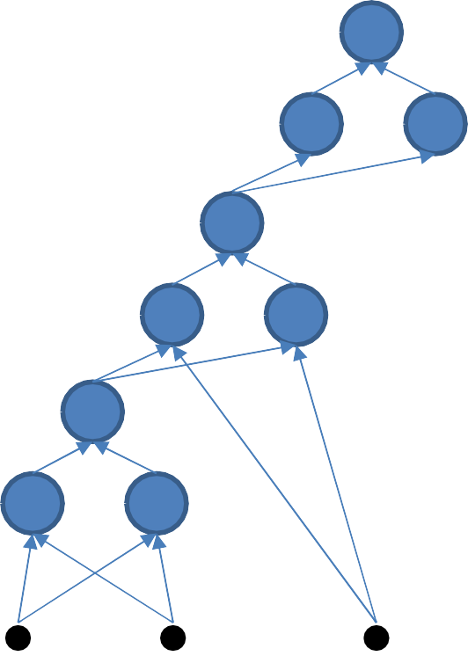

Size of a deep MLP
YZ
WX
00 01 11 10
00
01
9 perceptrons
11
10
W
X
Y
Z
An XOR needs 3 perceptrons
This network will require 3x3 = 9 perceptrons

Slide 57
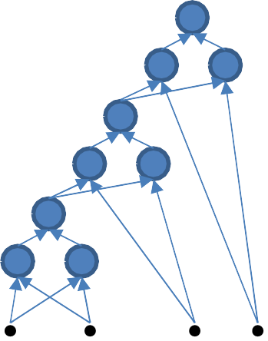
Size of a deep MLP
YZ
WX
00
01
11
11
01
YZ
10
10
UV
00 01 11 10
00
U V
W X Y Z
15 perceptrons
•
•
An XOR needs 3 perceptrons
This network will require 3x5 = 15 perceptrons

Slide 58
Size of a deep MLP
YZ
WX
00
01
11
11
01
YZ
10
10
UV
00 01 11 10
00
More generally, the XOR of N variables will require 3(N-1) perceptrons!!
U V
W X Y Z
•
•
An XOR needs 3 perceptrons
This network will require 3x5 = 15 perceptrons

Slide 59
One-hidden layer vs deep Boolean MLP
_{WX} YZ
00
Single hidden layer: Will require 2^{N-1}+1
perceptrons in all (including output unit)
Exponential in N
10
01
11
11
01
10
Will require 3(N-1) perceptrons in a deep network
Linear in N!!!
Can be arranged in only 2log₂(N) layers
_{UV} 00 01 11 10 ⁰⁰ YZ
• How many neurons in a DNF (one-hidden- layer) MLP for this Boolean function

Slide 60
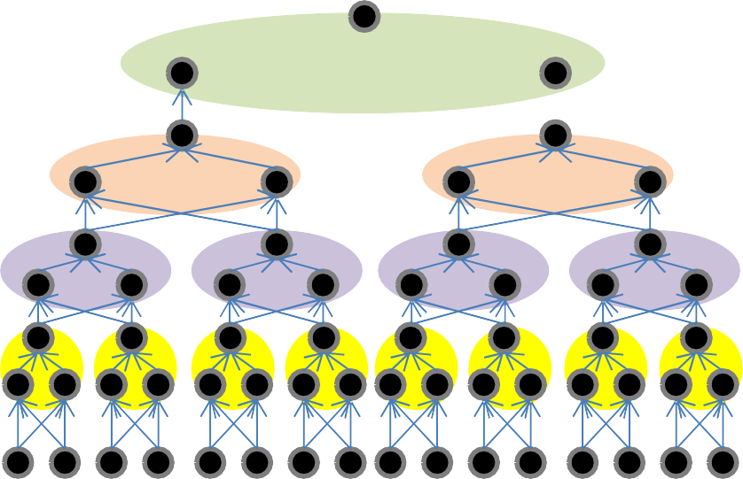

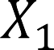
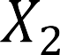




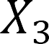
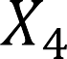
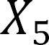
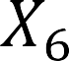
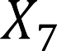
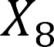
A better representation
1
Only layers
By pairing terms
2 layers per XOR
N
…
Notes:
XOR is associative (means we can group things in any order)

Slide 61

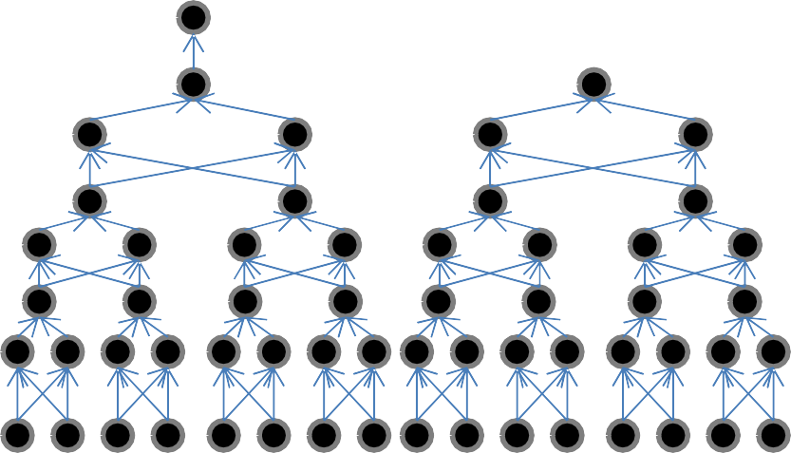
A better representation
XOR
XOR XOR XOR
1
Only layers
By pairing terms
2 layers per XOR
N
…

Slide 62






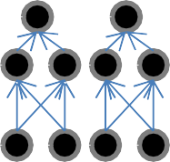
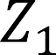
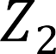



The challenge of depth
……
1
M
XOR
1
N
Using only K hidden layers will require O(2^{CN}) neurons in the Kth layer, where
–(K–1)/2
Because the output is the XOR of all the 2^{N-K/2} values output by the K-1th hidden layer
I.e. reducing the number of layers below the minimum will result in an exponentially sized network to express the function fully
A network with fewer than the minimum required number of neurons cannot model
the function

Slide 63
The actual number of parameters in a network
X₁ X₂ X₃ X₄ X₅
The actual number of parameters in a network is the number of
connections
– In this example there are 30
This is the number that really matters in software or hardware implementations
Networks that require an exponential number of neurons will require an exponential number of weights..

Slide 64
Recap: The need for depth
Deep Boolean MLPs that scale linearly with the number of inputs …
… can become exponentially large if recast using only one hidden layer

Slide 65
Network size: summary
An MLP is a universal Boolean function
But can represent a given function only if
It is sufficiently wide
It is sufficiently deep
Depth can be traded off for (sometimes) exponential growth of the width of the network
Optimal width and depth depend on the number of variables and the complexity of the Boolean function
Complexity: minimal number of terms in DNF formula to represent it

Slide 66
Story so far
Multi-layer perceptrons are Universal Boolean Machines
Even a network with a single hidden layer is a universal Boolean machine
But a single-layer network may require an exponentially large number of perceptrons
Deeper networks may require far fewer neurons than shallower networks to express the same function
Could be exponentially smaller

Slide 67
Q & A

Slide 68
Today
Multi-layer Perceptrons as universal Boolean functions
– The need for depth
MLPs as universal classifiers
– The need for depth
MLPs as universal approximators
A discussion of optimal depth and width

Slide 69

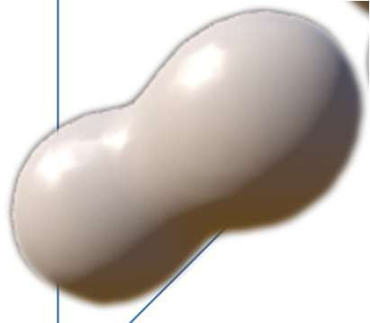

Recap: The MLP as a classifier
2
784 dimensions (MNIST)
784 dimensions
MLP as a function over real inputs
MLP as a function that finds a complex “decision boundary” over a space of reals

Slide 70






A Perceptron on Reals
x₁
1
x₂
x₃
x
0
w₁x₁+w₂x₂=T
2
x_{N}
x₁
i i
i
A perceptron operates on
real-valued vectors
x₂
x₁
– This is a linear classifier

Slide 71












Boolean functions with a real perceptron
0,1
1,1
0,1
1,1
0,1
1,1
X
Y
X
0,0
Y
1,0
0,0
X
1,0
0,0
Y
1,0
Boolean perceptrons are also linear classifiers
– Purple regions are 1

Slide 72
Composing complicated “decision” boundaries
x
Can now be composed into “networks” to compute arbitrary classification “boundaries”
2
x₁
Build a network of units with a single output that fires if the input is in the coloured area

Slide 73

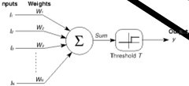
Booleans over the reals
x₂
x₁
x₂
x₁
The network must fire if the input is in the coloured area

Slide 74
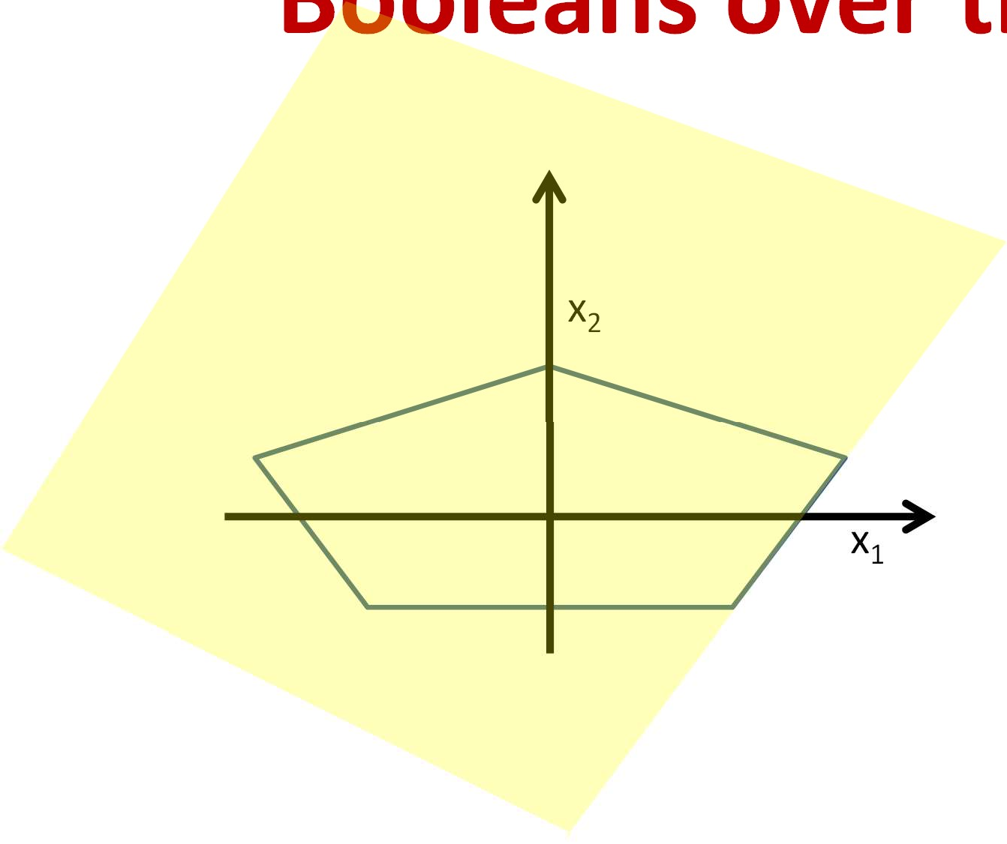
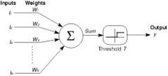
he reals
Booleans over t
x₂
x₁
x₂
x₁
The network must fire if the input is in the coloured area

Slide 75
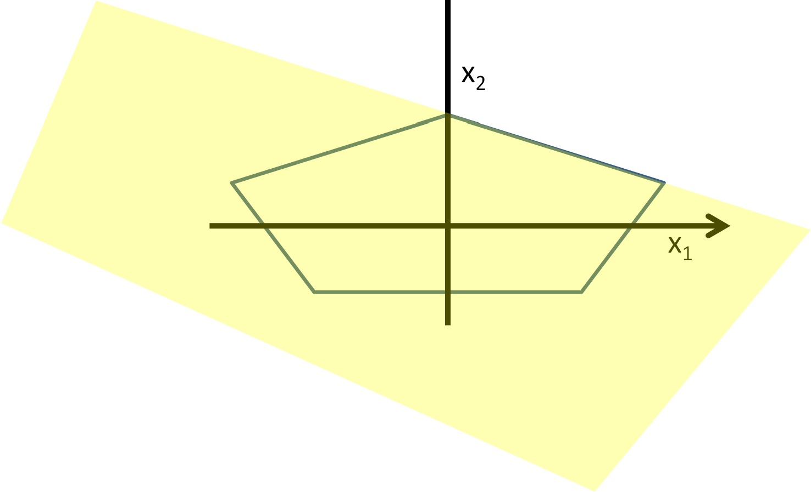

Booleans over the reals
x₂
x
1
x₂
x₁
The network must fire if the input is in the coloured area

Slide 76

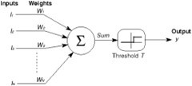
Booleans over the reals
x₂
x₁
x₂
x₁
The network must fire if the input is in the coloured area

Slide 77


Booleans over the reals
x₂
x₁
x₂
x₁
The network must fire if the input is in the coloured area

Slide 78






he reals
Booleans over t
x₂
x₁
3
N
x
i
4
2
i=1
AND
4
3
3
5
y₁ y₂ y₃ y₄ y₅
4
x₁
4
3
3
4
x₂
x₁
The network must fire if the input is in the coloured area
The AND compares the sum of the hidden outputs to 5
NB: What would the pattern be if it compared it to 4?
Notes:
NB: What would the pattern be if it compared it to 4? Star

Slide 79

More complex decision boundaries
OR
AND
AND
x₂
x₁
x₁ x₂
Network to fire if the input is in the yellow area
“OR” two polygons
A third layer is required

Slide 80

Complex decision boundaries
Can compose arbitrarily complex decision boundaries

Slide 81







Complex decision boundaries
OR
AND
x₁ x₂
Can compose arbitrarily complex decision boundaries

Slide 82
Complex decision boundaries
OR
AND
x₁ x₂
Can compose arbitrarily complex decision boundaries
With only one hidden layer!
How?

Slide 83






Exercise: compose this with one hidden layer
x₂
x₁
x₁ x₂
How would you compose the decision boundary to the left with only one hidden
layer?

Slide 84






Composing a Square decision boundary
2
2
4
2
2
4
Σ y_{i} ≥ 4?
i=1
The polygon net
y₁ y₂ y₃ y₄
x₂
x₁

Slide 85


Composing a pentagon
2
2
3
4
4
3
3
5
4
4
4
2
2
3
3
5
Σ y_{i} ≥ 5?
i=1
y₁ y₂ y₃ y₄ y₅
2
The polygon net
x₂
x₁

Slide 86



Composing a hexagon
3
3
4
3
5
5
5
4
6
4
5
5
3
4
5
4
3
3
N
Σ y_{i} ≥ 6?
i=1
The polygon net
y₁ y₂ y₃ y₄
y₅
y₆
x₂
x₁

Slide 87

How about a heptagon
What are the sums in the different regions?
A pattern emerges as we consider N > 6..
N is the number of sides of the polygon

Slide 88

16 sides
What are the sums in the different regions?
– A pattern emerges as we consider N > 6..

Slide 89

64 sides
What are the sums in the different regions?
– A pattern emerges as we consider N > 6..

Slide 90

1000 sides
What are the sums in the different regions?
– A pattern emerges as we consider N > 6..

Slide 91

Composing a circle
N
N
Σ y_{i} ≥ 𝑁?
i=1
N/2
The circle net
Very large number of neurons
Sum is N inside the circle, N/2 outside almost everywhere
Circle can be at any location

Slide 92



Composing an arbitrary figure
𝑲𝑵
𝑵
Σ 𝐲_{𝒊} − _{𝟐} ≥ 𝟎?
𝒊=𝟏
Just fit in an arbitrary number of circles
More accurate approximation with greater number of smaller circles
Can achieve arbitrary precision

Slide 93
MLP: Universal classifier
𝑲𝑵
𝑵
Σ 𝐲_{𝒊} − _{𝟐} ≥ 𝟎?
𝒊=𝟏
MLPs can capture any classification boundary
A one-hidden-layer MLP can model any classification boundary
MLPs are universal classifiers

Slide 94



Depth and the universal classifier
x₂
x₁
x₁ x₂
Deeper networks can require far fewer neurons
– 12 vs. ~infinite hidden neurons in this example

Slide 95
Optimal depth in generic nets
We look at a different pattern:
“worst case” decision boundaries
For threshold-activation networks
Generalizes to other nets

Slide 96

Optimal depth
𝑲𝑵
𝑵
Σ 𝐲_{𝒊} − _{𝟐} > 𝟎?
𝒊=𝟏
A naïve one-hidden-layer neural network will require infinite hidden neurons

Slide 97



Optimal depth
Two hidden-layer network: 56 hidden neurons

Slide 98






Optimal depth
1
2 | 3 | 4
6 | 7 | 8
10 | 11 | 12
5
9
13
14
15
16
1 2 3
16
Two-hidden-layer network: 56 hidden neurons
– 16 neurons in hidden layer 1

Slide 99

Optimal depth
Two-hidden-layer network: 56 hidden neurons
16 in hidden layer 1
40 in hidden layer 2
57 total neurons, including output neuron

Slide 100

Optimal depth
1
2 | 3 | 4
6 | 7 | 8
10 | 11 | 12
5
9
13
14
15
16
1 2 3
16
But this is just

Slide 101

Optimal depth
But this is just
The XOR net will require 16 + 15x3 = 61 neurons
46 neurons if we use a two-neuron XOR model

Slide 102

Optimal depth
Grid formed from 64 lines
– Network must output 1 for inputs in the yellow regions

Slide 103

Actual linear units
….
1 2 3
64
64 basic linear feature detectors

Slide 104

Optimal depth
….
….
Two hidden layers: 608 hidden neurons
64 in layer 1
544 in layer 2
609 total neurons (including output neuron)

Slide 105


Optimal depth
….
….
….
XOR network (12 hidden layers): 253 neurons
– 190 neurons with 2-gate XOR
The difference in size between the deeper optimal (XOR) net and shallower nets increases with increasing pattern complexity and input dimension

Slide 106
Depth: Summary
The number of neurons required in a shallow network is potentially exponential in the dimensionality of the input
(this is the worst case)
Alternately, exponential in the number of statistically independent features

Slide 107
Story so far
Multi-layer perceptrons are Universal Boolean Machines
Even a network with a single hidden layer is a universal Boolean machine
Multi-layer perceptrons are Universal Classification Functions
Even a network with a single hidden layer is a universal classifier
But a single-layer network may require an exponentially large number of perceptrons than a deep one
Deeper networks may require far fewer neurons than shallower networks to express the same function
Could be exponentially smaller
Deeper networks are more expressive

Slide 108
Today
Multi-layer Perceptrons as universal Boolean functions
The need for depth
MLPs as universal classifiers
The need for depth
MLPs as universal approximators
A discussion of optimal depth and width

Slide 109
MLP as a continuous-valued regression
T₁ T₁
1
1
f(x)
x
+
T
1 2 x
T
1
-1
T₂
T₂
A simple 3-unit MLP with a “summing” output unit can generate a “square pulse” over an input
Output is 1 only if the input lies between T₁ and T₂
T₁ and T₂ can be arbitrarily specified

Slide 110

MLP as a continuous-valued regression
2
1
n
T₁ T₁
f(x)
1 2 x
x
1
1
x
T T
1
-1
T₂
+
1
n
T₂
2
A simple 3-unit MLP can generate a “square pulse” over an input
An MLP with many units can model an arbitrary function over an input
To arbitrary precision
Simply make the individual pulses narrower
A one-hidden-layer MLP can model an arbitrary function of a single input

Slide 111
For higher dimensions
N/2
+
-N/2
0
1
An MLP can compose a cylinder
– in the circle, 0 outside

Slide 112









MLP as a continuous-valued function
1
+
2
2
1
n
n
MLPs can actually compose arbitrary functions in any number of dimensions!
Even with only one hidden layer
As sums of scaled and shifted cylinders
To arbitrary precision
By making the cylinders thinner
The MLP is a universal approximator!

Slide 113
Today
Multi-layer Perceptrons as universal Boolean functions
The need for depth
MLPs as universal classifiers
The need for depth
MLPs as universal approximators
A discussion of sufficient depth and width

Slide 114
The issue of depth
Previous discussion showed that a single-hidden-layer
MLP is a universal function approximator
Can approximate any function to arbitrary precision
But may require infinite neurons in the layer
More generally, deeper networks will require far fewer neurons for the same approximation error
True for Boolean functions, classifiers, and real-valued functions
But there are limitations…

Slide 115
Q & A

